Slide 1

Introduction to Power BI
Power BI Days
02/29/2020

Slide 2


Jimmy Gibson
Distributed Solutions, Inc.
Business Intelligence Team Leader
Founder & CEO
Business and Data Analytics Solutions, LLC
Better known as BADAS, LLC
/jimmygibson-badasLLC
Jimmy.Gibson@badasllc.com
http://badasllc.com

Slide 3
Agenda
What is Power BI?
Power BI Architecture (very high level)
Getting Started with Power BI
Power BI Desktop Tour
Power BI Service Tour

Slide 4

Before we begin….

Slide 5
More Than 90% of Data in the World Today Has Been Created in The Last Three Years Alone!
Cloud
Public, private or third party platforms
Web
Data publicly available on the web
Media
Images, videos, audios, podcasts
Social media platforms like Facebook, Twitter, and Youtube
Databases
Traditional and modern databases
IoT
Data generated from the interconnection of IoT devices
Notes:
Approx 1.7 MB per second
Total accumulated data is approx. 44 zettabytes (44 trillion gigabytes)

Slide 6


Only 12% of Data Collected is Ever Analyzed!
Why?
Lack of analytics tools (Nearly everyone across the organization engages in software yet less than 25% have access to analytical insights)
Various data silos
Challenge of determining which data is valuable

Slide 7
Only 12% of Data Collected is Ever Analyzed!
The accumulated volume of all big data is approximately 44 zettabytes or 44 trillion GB.
New information generated per second for every human being is approximately 1.7 megabytes.
Every minute Facebook users send roughly 31.25 million messages
On YouTube alone, 300 hours of video are uploaded every minute.

Slide 8
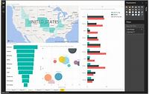
Business Intelligence (BI) Defined
Business Intelligence is a set of techniques, tools, and methodologies for the acquisition and transformation of raw data into meaningful information for business analysis purposes.

Slide 9
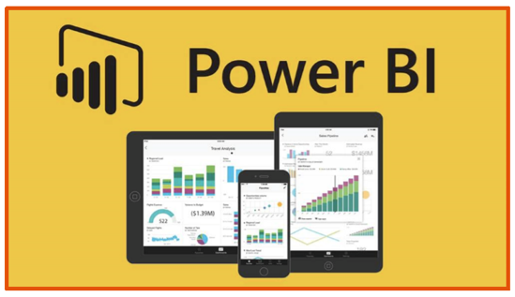
What is Power BI?
Power BI is a business analytics solution that lets you
Visualize your data
Share insights across your organization
Embed them in your app or website
Connect to hundreds of data sources and bring your data to life with live dashboards and reports

Slide 10
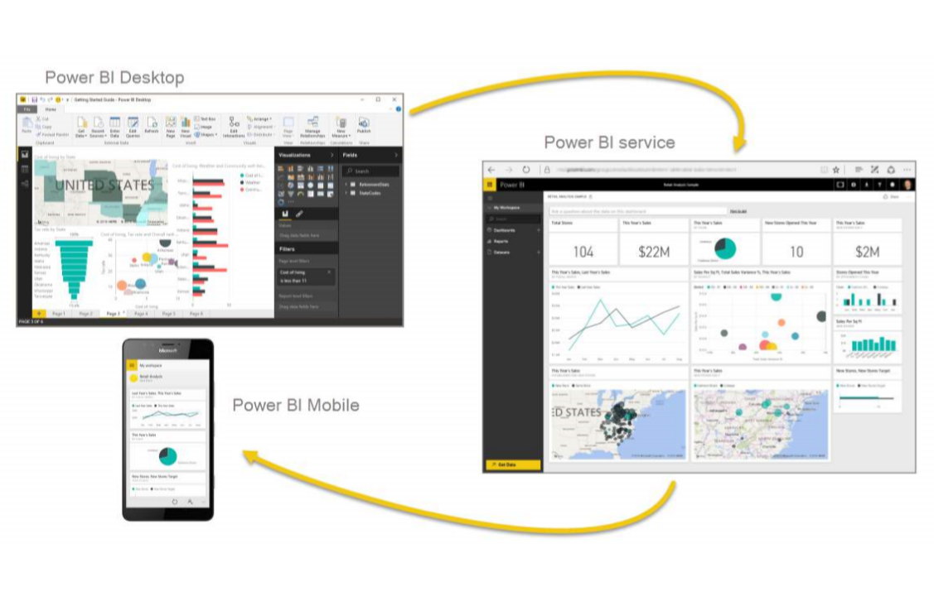
Power BI Suite
Power BI Desktop app is used to create reports
Power BI Services (Software as a Service - SaaS) is used to publish the reports
What is Power BI?
Power BI mobile app is used to view the reports and dashboards.
Notes:
Emphasize: Power BI is NOT a database
Power BI Desktop is the platform where you can ingest, transform, and shape your data
Power BI Web Service is where you publish reports for consumers
Power BI Mobile allows consumers to interact with data on the fly

Slide 11
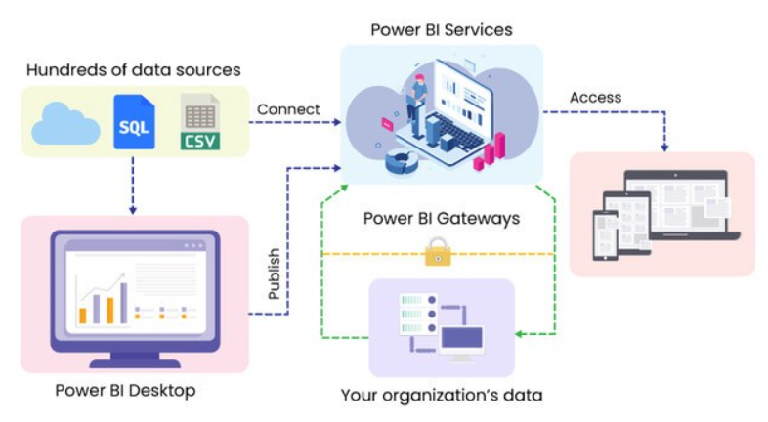
Power BI Architecture
Notes:
Power BI is NOT a database. The database is in the top left. (Shan – rebuild this)

Slide 12
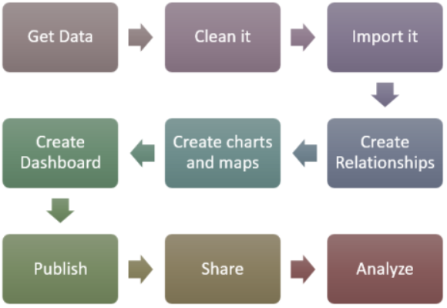
Power BI Content Development Workflow
Power BI Desktop
Power BI Service
Notes:
Power BI is NOT a database. The database is in the top left. (Shan – rebuild this)

Slide 13
Getting Started With Power BI
Download Power BI desktop
https://aka.ms/pbiSingleInstaller
http://powerbi.com
Get data!
Connect to 80+ sources
Prepare your data
Shape, transform, and clean data for analysis
Join and model data from multiple data sources/types
Visualize and Share your data!
Notes:
Demo: get data from SP list – use PGH 311 data

Slide 14

Desktop and Power BI Service Tour
Notes:
Demo 1

Slide 15
Sharing Your Masterpiece
Sharing Your Masterpiece
Power BI Reports are consumed in the service (app.powerbi.com)
To keep things consistent (and connected to the source), you’ll set up automation
There is an on-prem option (Power BI report server)
Notes:
Publish to the service
Service
My workspace (sandbox)
Workspace vs App
Automated Refresh
Gateways

Slide 16
Tips and Tricks
Process:
Start with end-user requirements
Ensure your devs have support (PUG)
Beware of unstructured data
Use the rest of the Power Platform
PowerApps for quick data collection, Flow for process automation
Train your end users!

Slide 17
Resources
https://SQLBI.com/
intermediate to advanced
2 free trainings – one on DAX and one on M (data model/ETL layer)
https://community.powerbi.com/
ask questions
https://ideas.powerbi.com/forums/265200-power-bi-ideas
create and vote ideas
https://www.youtube.com/channel/UCy2rBgj4M1tzK-urTZ28zcA
beginner to intermediate Youtube
https://powerpivotpro.com/
beginner to intermediate
https://www.youtube.com/channel/UCFp1vaKzpfvoGai0vE5VJ0w/videos
All kinds of videos
PowerBI.Tips – themes and background templates
Power BI template gallery

